Slide 1
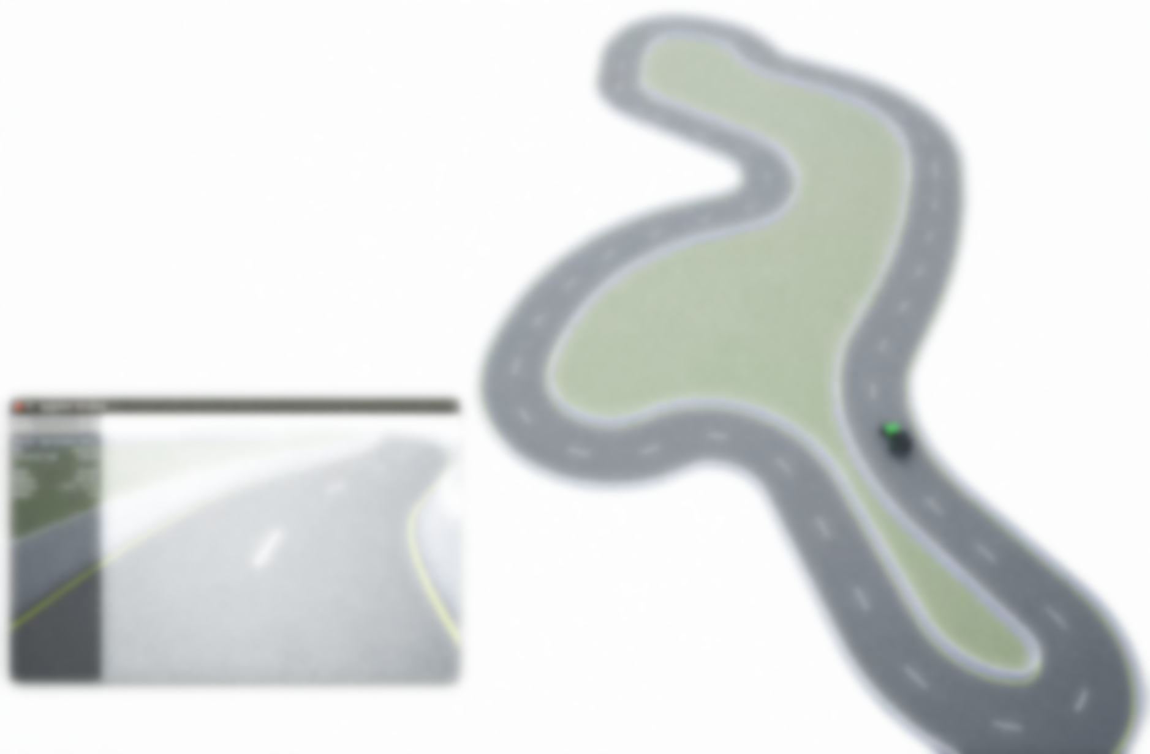
MoCAD: Carla-python Experimental Course
Ⅲ Control a Vehicle by PID

Slide 2
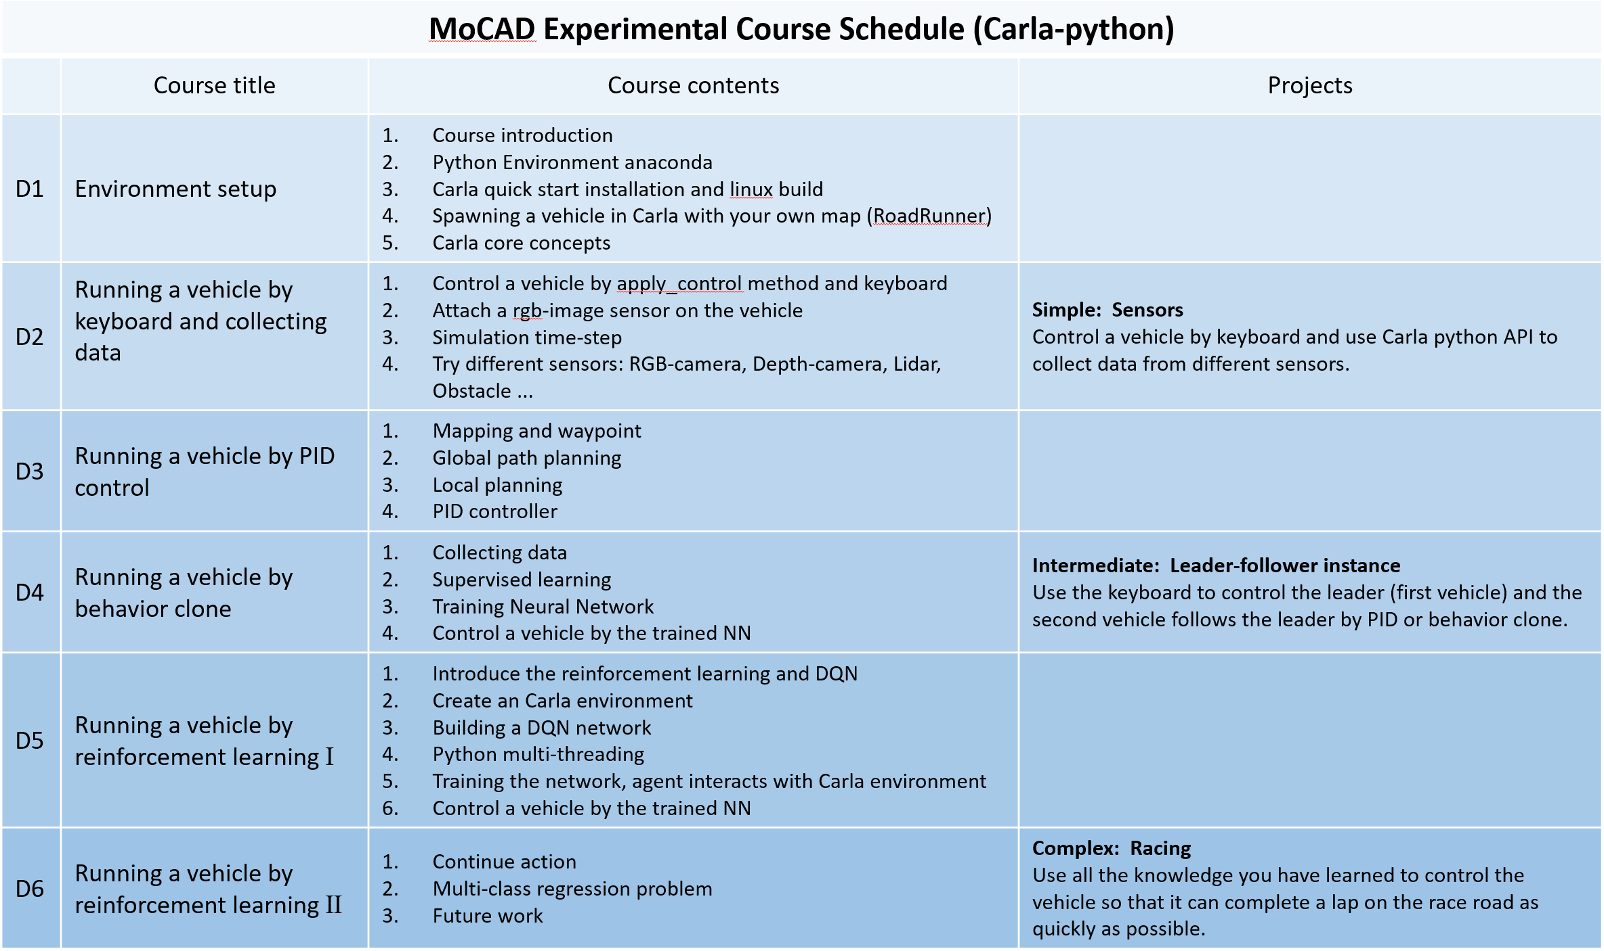
Lesson 1 - 2
Study Carla
Use Carla

Slide 3
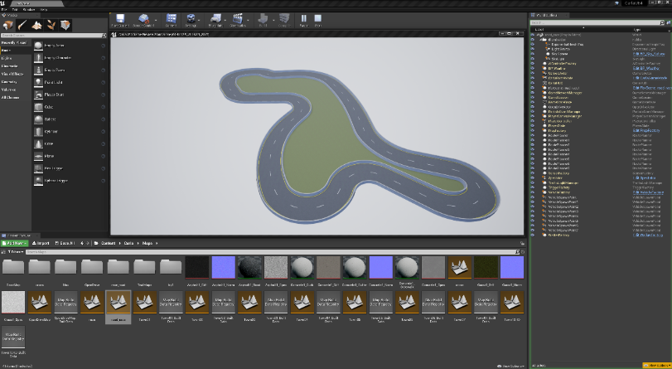
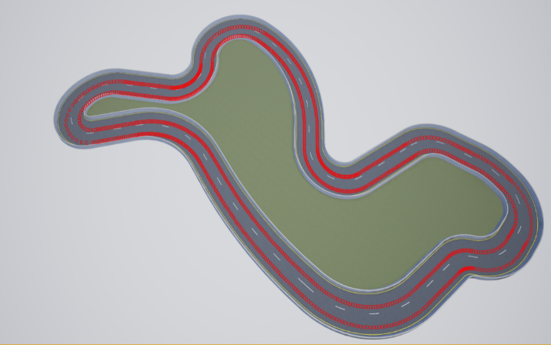
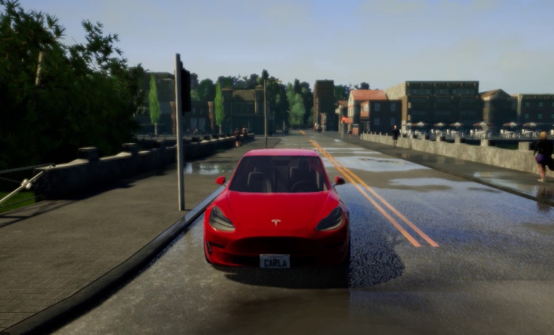
Lesson 1
Summary
RoadRunner Plugin and import map;
Server – Client ；
Core concepts;
Map waypoints;
Vehicle spawn;
Move the vehicle based on the waypoints;
Demo
Carla Simulator
Waypoints
Vehicle spawn
Notes:
1. Waypoints transform location & rotation
2. Actor → blueprint → set attribution → transform point → spawn (vehicle, sensor, walker, bicycle …)

Slide 4
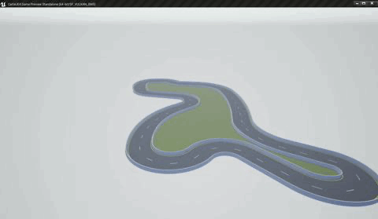
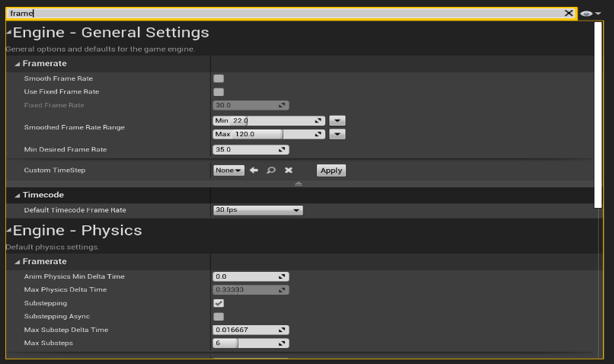
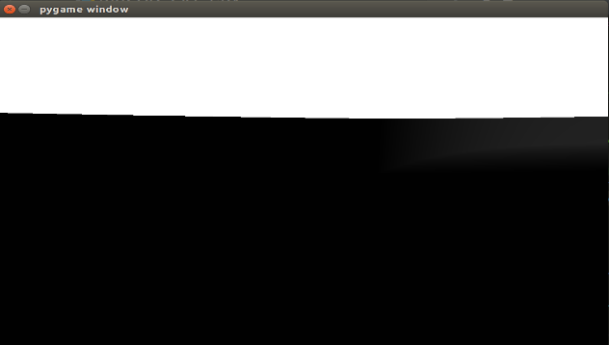
Lesson 2
Summary
Spawn sensors (rgb-camera);
Server – client FPS;
Synchronous or asynchronous;
Demo
rgb-camera
Server – client FPS
Sensors
Notes:
Sensor attach_to= vehicle, listen_to (process function)
Synchronous and asynchronous, eyes– client brain(two situation)

Slide 5
Outline
Mapping (UE4 RoadRunner)
Draw waypoints and Global path planning
Local planning step by step
PID controller
Notes:
传统无人驾驶的控制步骤，主要讲解 Local planning和PID controller的 Carla 实现
为什么要画waypoints，你对地图真的了解吗？（x,y,z）velocity pitch,roll,yawl
Local planning 车辆是如何移动起来的呢？
PID controller的前世今生

Slide 6
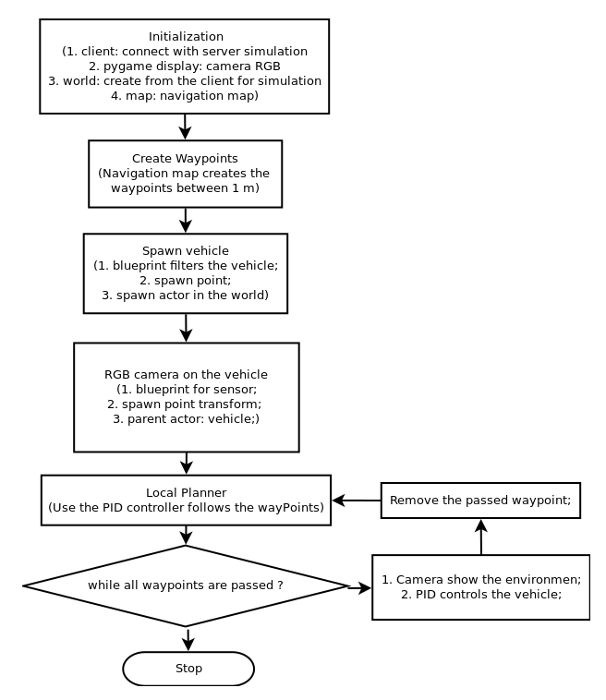
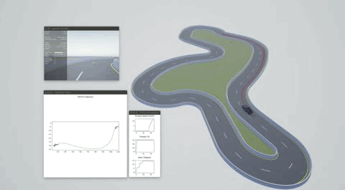
1. Mapping, draw waypoints
UE4_RoadRunner_Carla ( Day 1 )
Control a vehicle by PID
Notes:
直观上感受使用PID方法控制车辆，实验目标拆解： （1）按waypoints规划线路 （2）根据车辆位置信息和 waypoint信息做local planning （3）PID控制，横向和纵向。
要和Carla pythonAPI结合到一起考虑问题

Slide 7
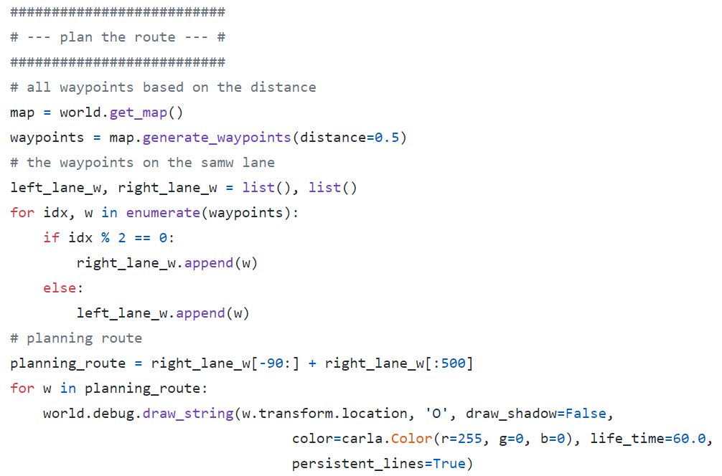

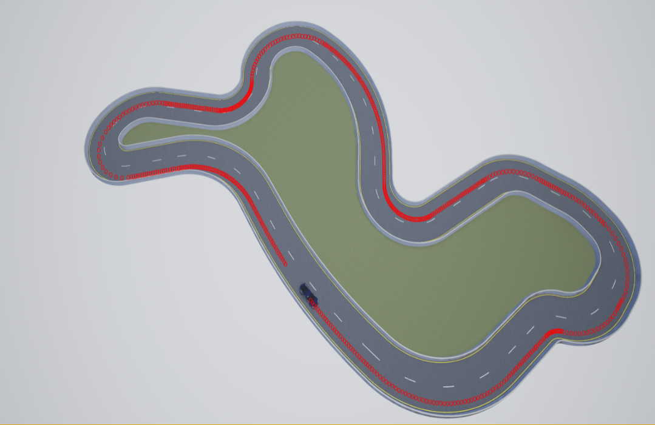
2. Draw waypoints and Global path planning
A Global path
All waypoints
A Global path

Slide 8
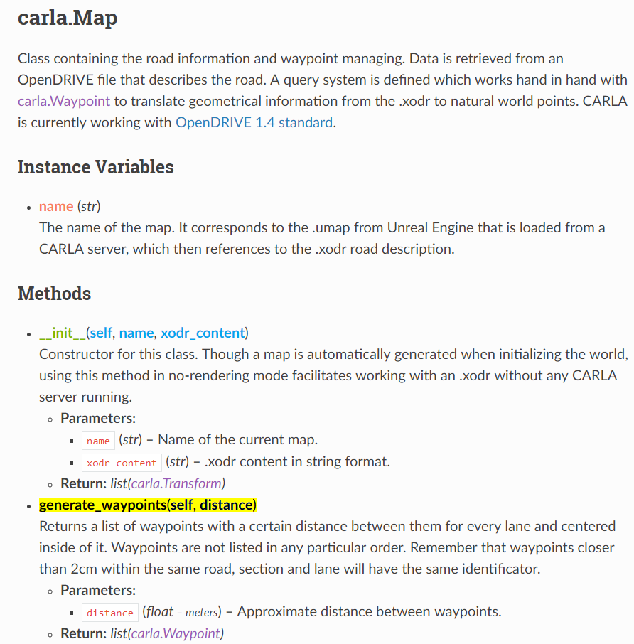
2. Draw waypoints and Global path planning
PythonAPI
Notes:
Waypoints最近不能小于2cm

Slide 9
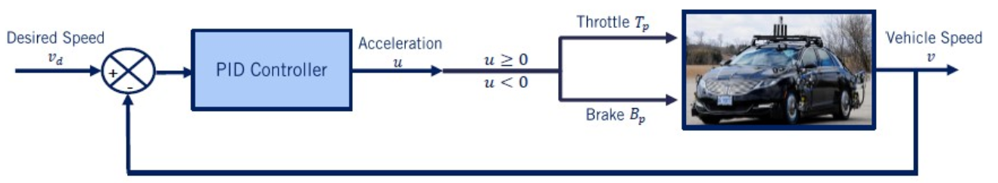
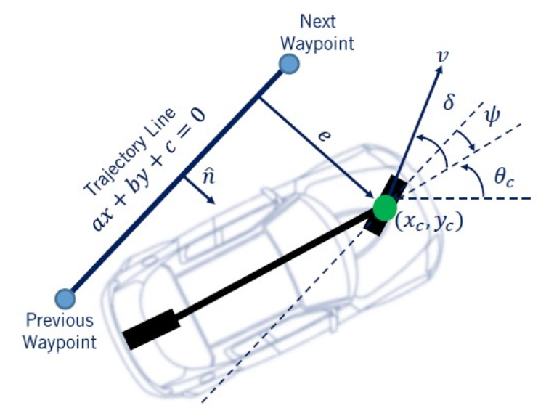
3. Local Planning
Use PID controller to achieve the local planning
1. Longitudinal control (throttle and brake: velocity)
2. Lateral control (steer: orientation)
Notes:
用PID控制器在vehicle position and next waypoint之间实现了local planning

Slide 10
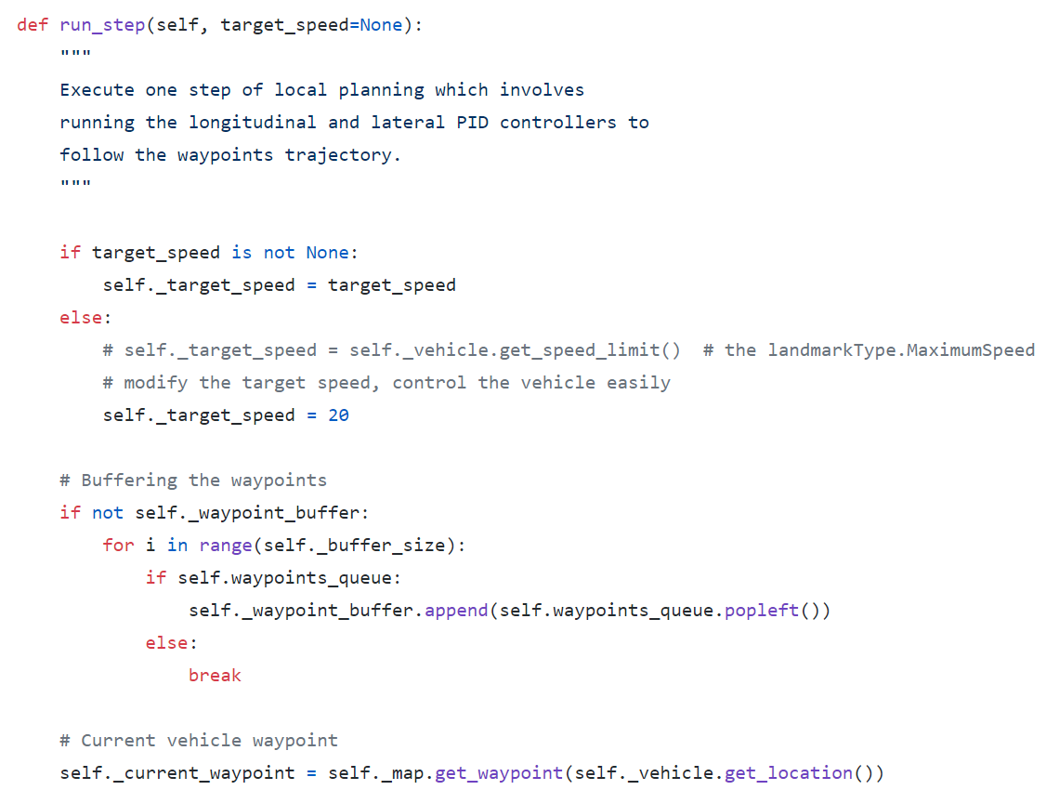
3. Local Planning
Local planning：current waypoint and next waypoint
1. Target：velocity and position
2. Current vehicle：velocity and position
Notes:
目标的waypoint应该包含位置和速度两方面信息，速度信息我们mapping中没有，可以在landmarkType中提取也可以自行设定；

Slide 11
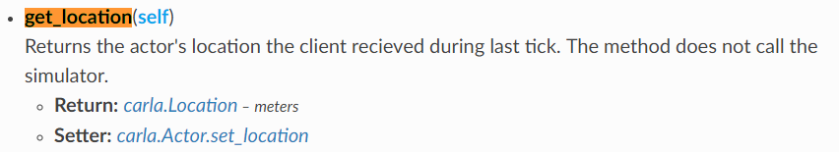
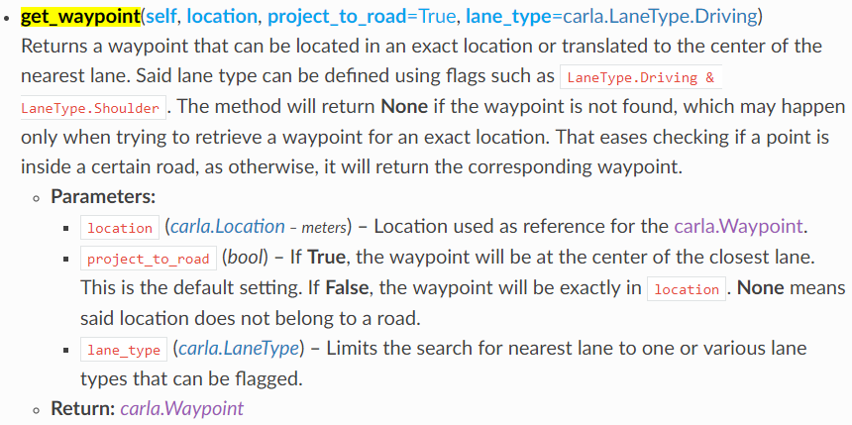
2. Draw waypoints and Global path planning
PythonAPI
Carla.Actor
Carla.Map
Notes:
官方手册和github issues

Slide 12
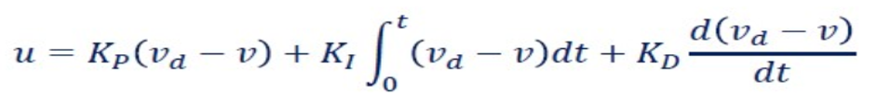
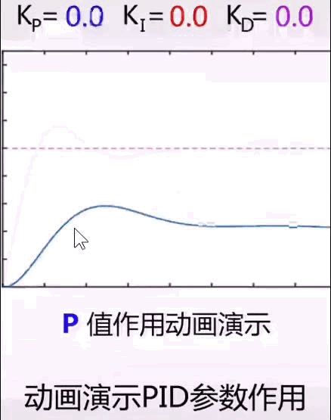
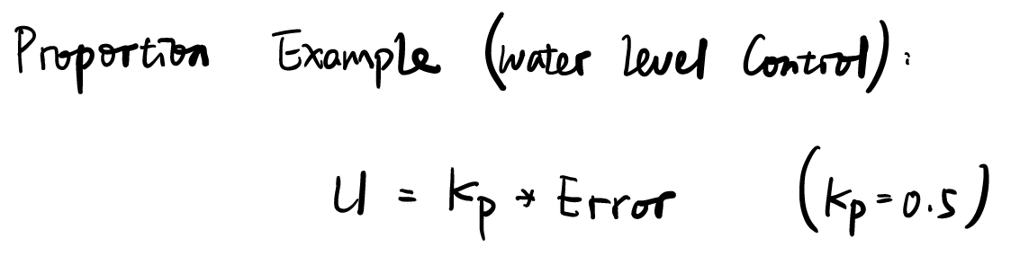
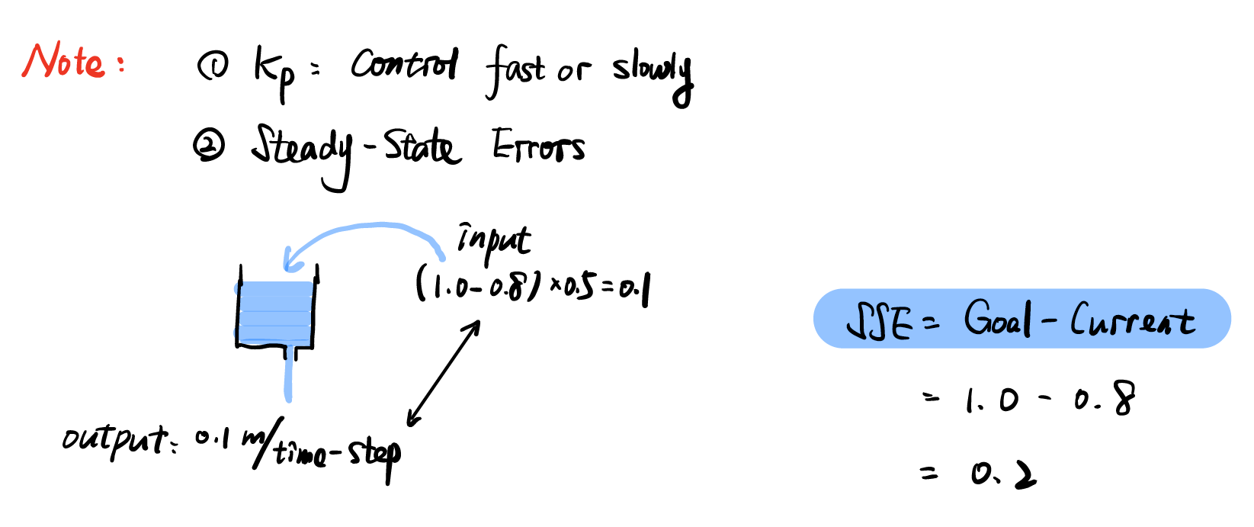
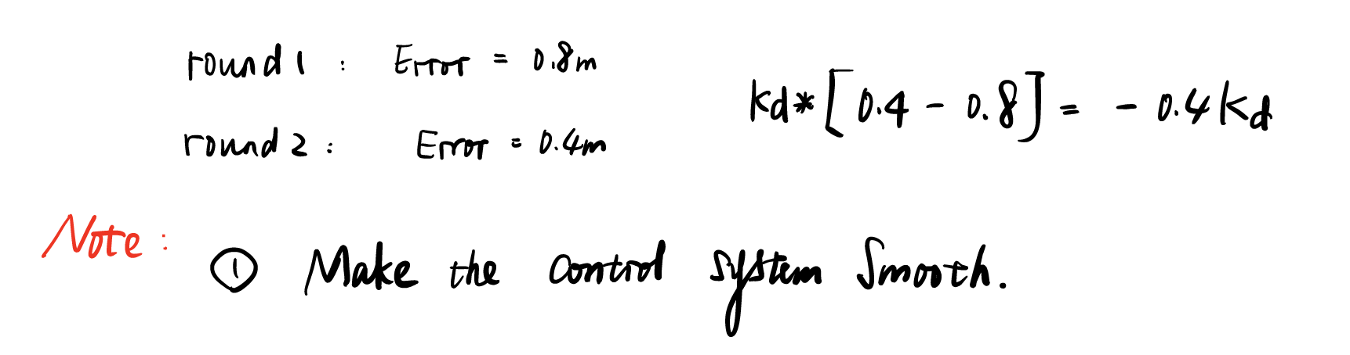
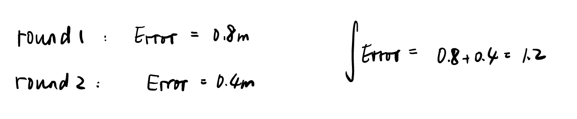
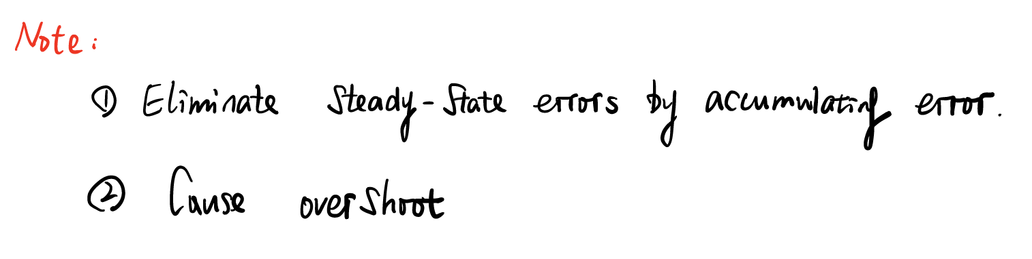
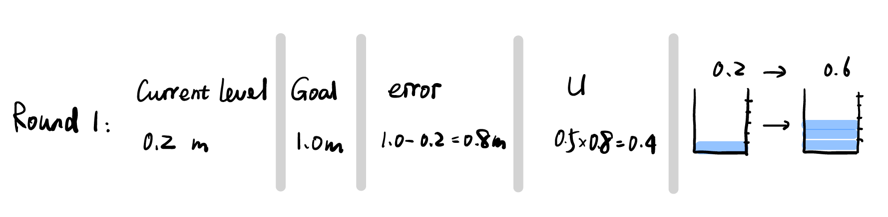
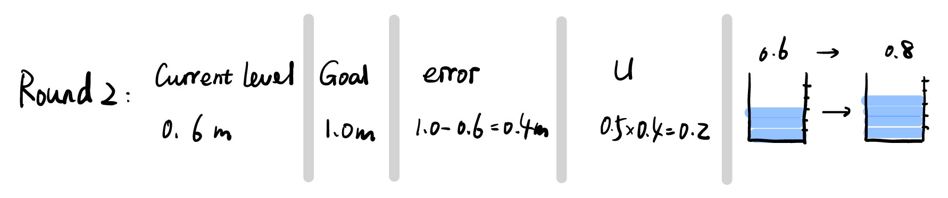
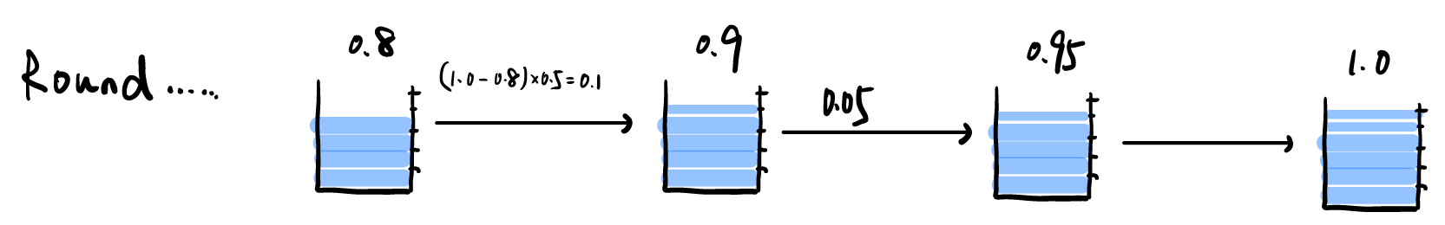
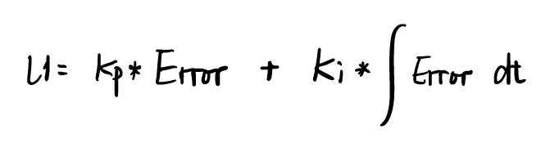
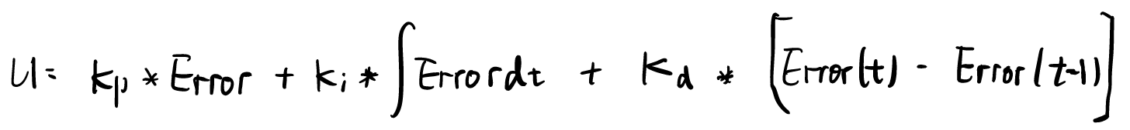
4. PID controller
PID （Proportion，Integration, Differentiation）controller： Longitudinal control velocity
：
：Integration
：Integration
Notes:
终于轮到PID, 讲一讲PID 控制的原理
有了target和current信息后就可以使用PID控制器了
比例：正确方向上成比例放缩，掌握现在
积分： 累计速度误差，加速调节，证实过往
微分：预测速度，抑制积分项引起的超调，预测未来

Slide 13
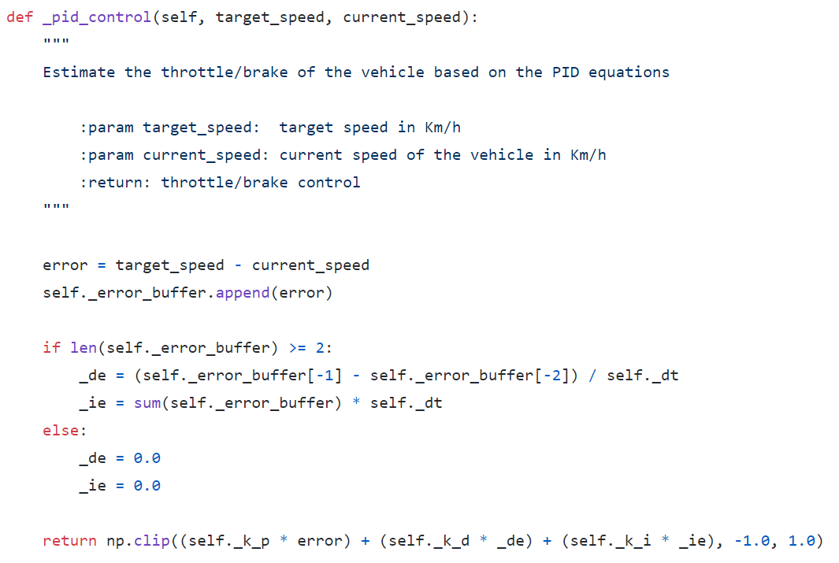
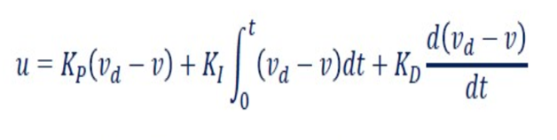
4. PID controller
PID controller： Longitudinal control velocity
No Carla PythonAPI
Numpy np.clip [-1.0, 1.0]
Notes:
终于轮到PID
有了target和current信息后就可以使用PID控制器了
比例：正确方向上成比例放缩，
积分： 累计速度误差，加速调节
微分：预测速度，抑制积分项引起的超调。

Slide 14
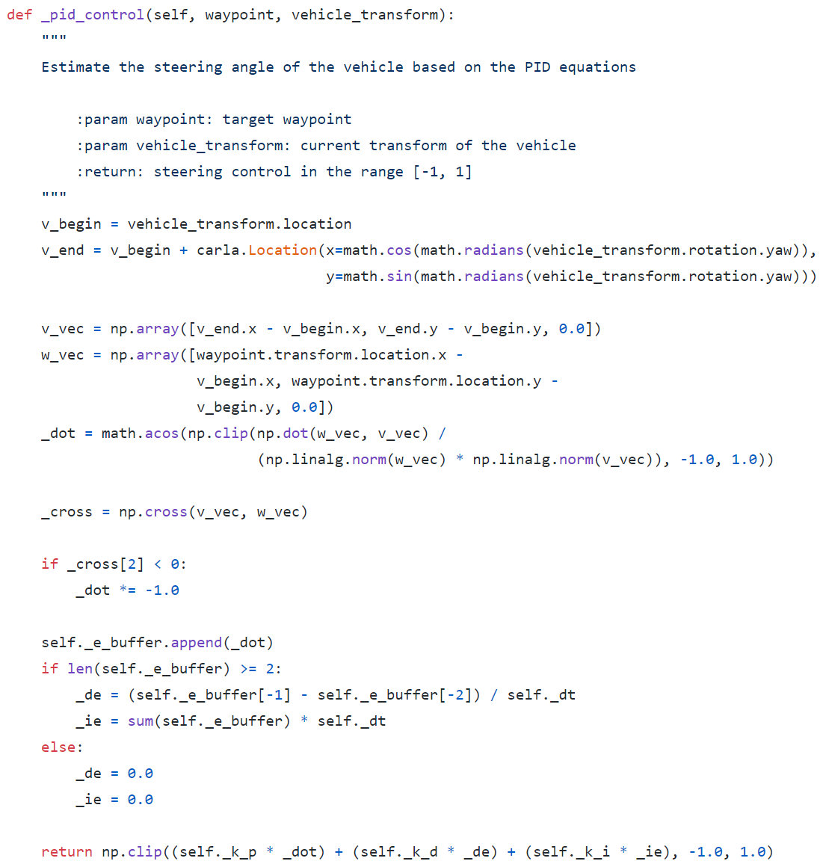
4. PID controller
PID controller： Lateral control orientation
1.Orientation：vehicle and target waypoint
2. Proportional
3. Integral and derivative
Notes:
https://medium.com/@dingyan7361/three-methods-of-vehicle-lateral-control-pure-pursuit-stanley-and-mpc-db8cc1d32081
介绍不同的控制方法 In carla

Slide 15
5. Better performance
Mapping，more waypoints
Limit max speed
Client FPS, Computer performance
Other controller
Notes:
如何提高控制效果呢？其他都是作弊，换个控制器试试呢

Slide 16
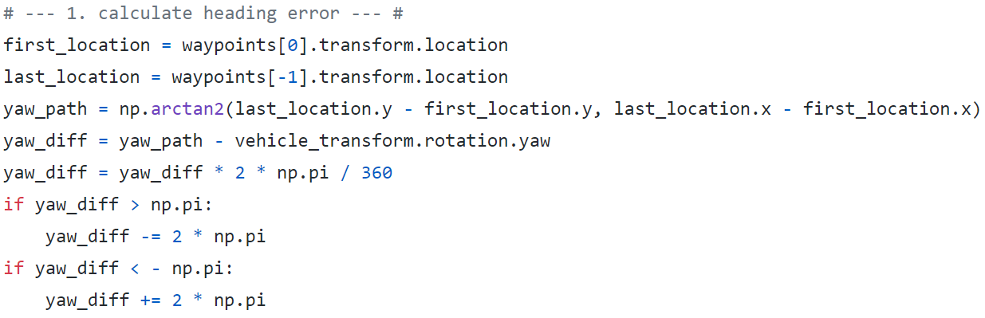
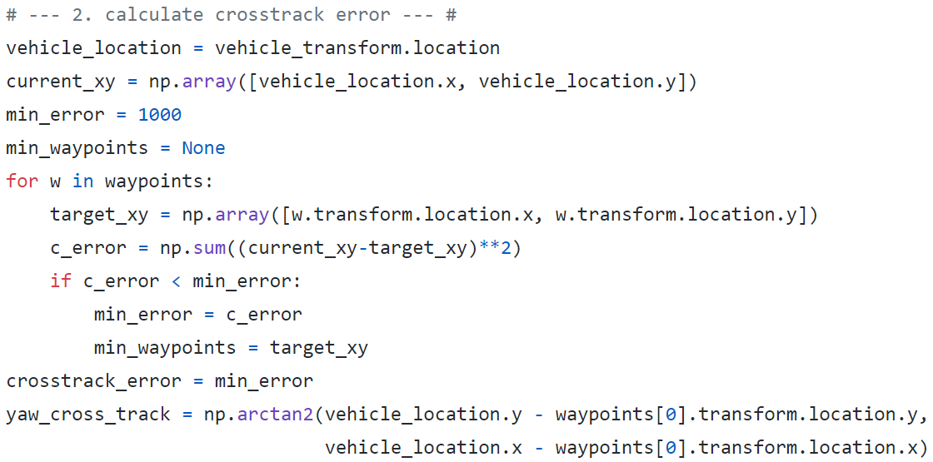
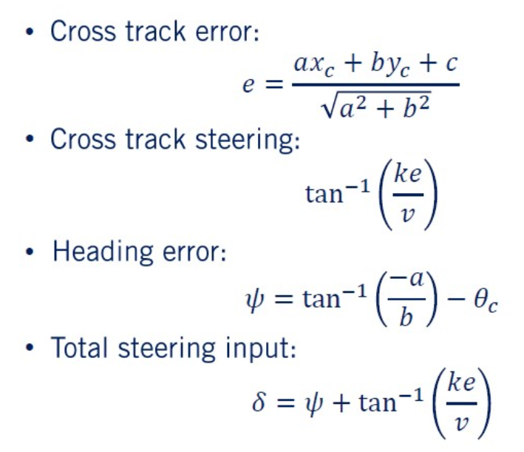
5. Better performance -- Stanley controller
Stanley controller： Steer
Notes:
改变控制器？Stanley控制器没有调好啊，效果不好。
如果内容不够的话，可以添加 pygame display的部分。

Slide 17
MoCAD: Carla-python Experimental Course
Control a Vehicle by PID
Design a new global path;
Show the vehicle state information;
Try different controller Stanley, PI, PD;
Carla over !
Notes:
回顾课程（1）planning（2）sensor（3）local controller；
能否在新的脚本上做一些改进呢？真的掌握知识了吗

Slide 18
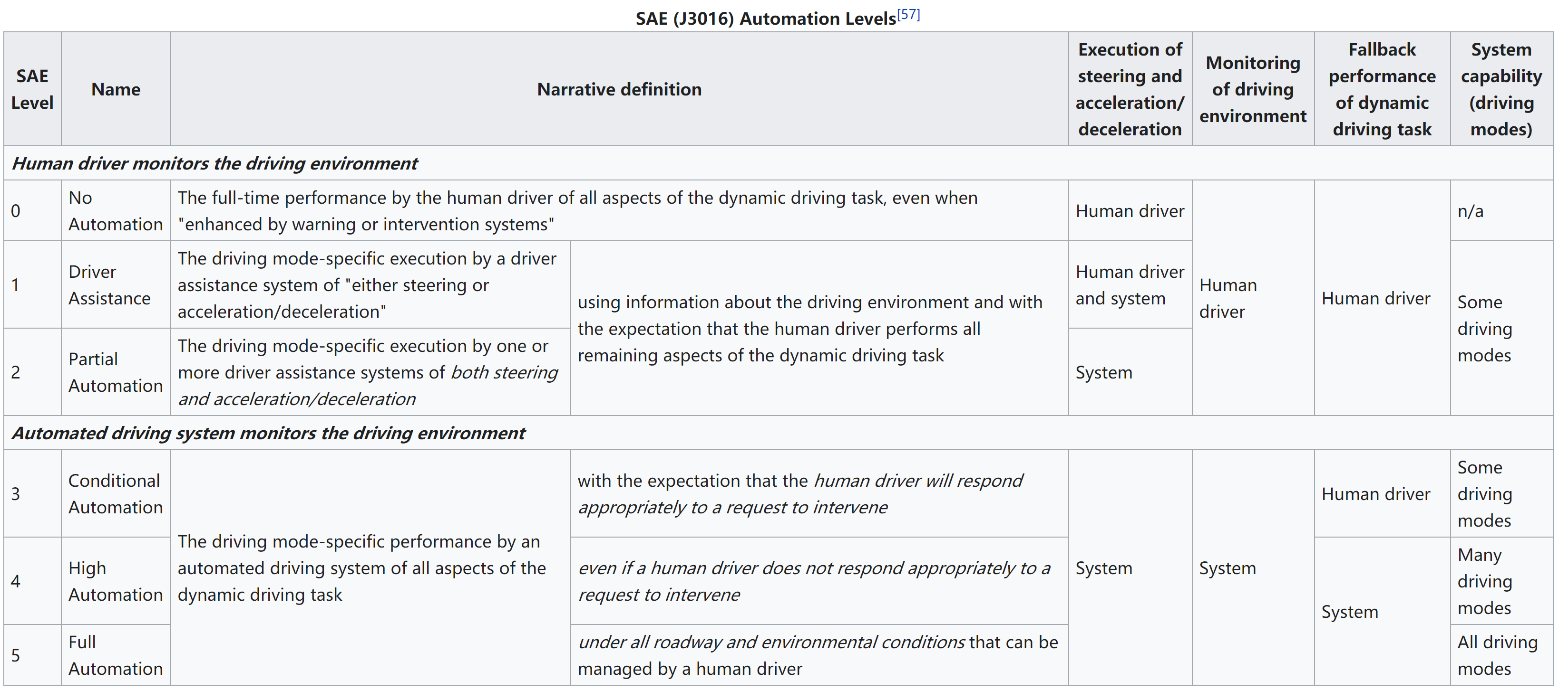
(J3016) Automation Levels
Notes:
SAE International is the global leader in technical learning for the mobility industry.
https://www.sae.org/standards/content/j3016_201806/preview/
Level 2 lane keep
Level3 system require full user alertness;
Level4 system do not
Level 4 a restricted operational design domain ODD
Weather, lane surface and type …

Slide 19
Try more
Assisted driving
L0 → Keyboard;
L1 → keyboard + Lane invasion detector → Lane line keeping;
L2 → keyboard + Obstacle detector → Safe distance;
Autonomous driving
L3 → PID + Human driver → … ;
L4 →
L5 →

